Slide 1
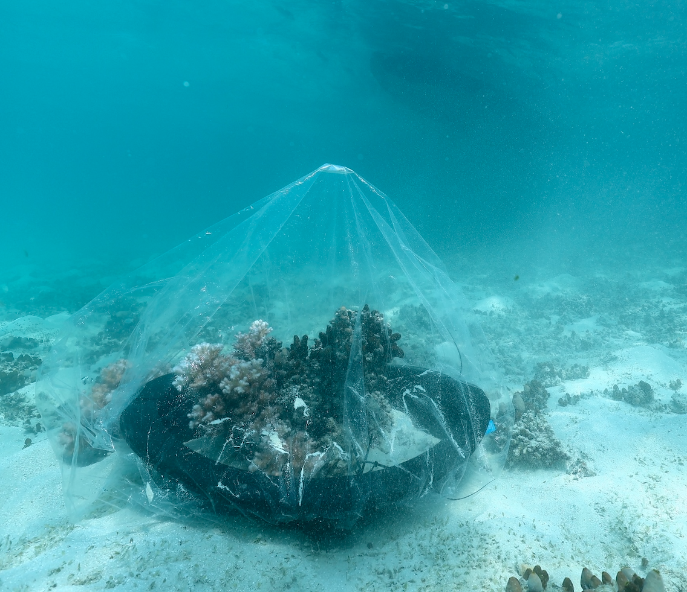
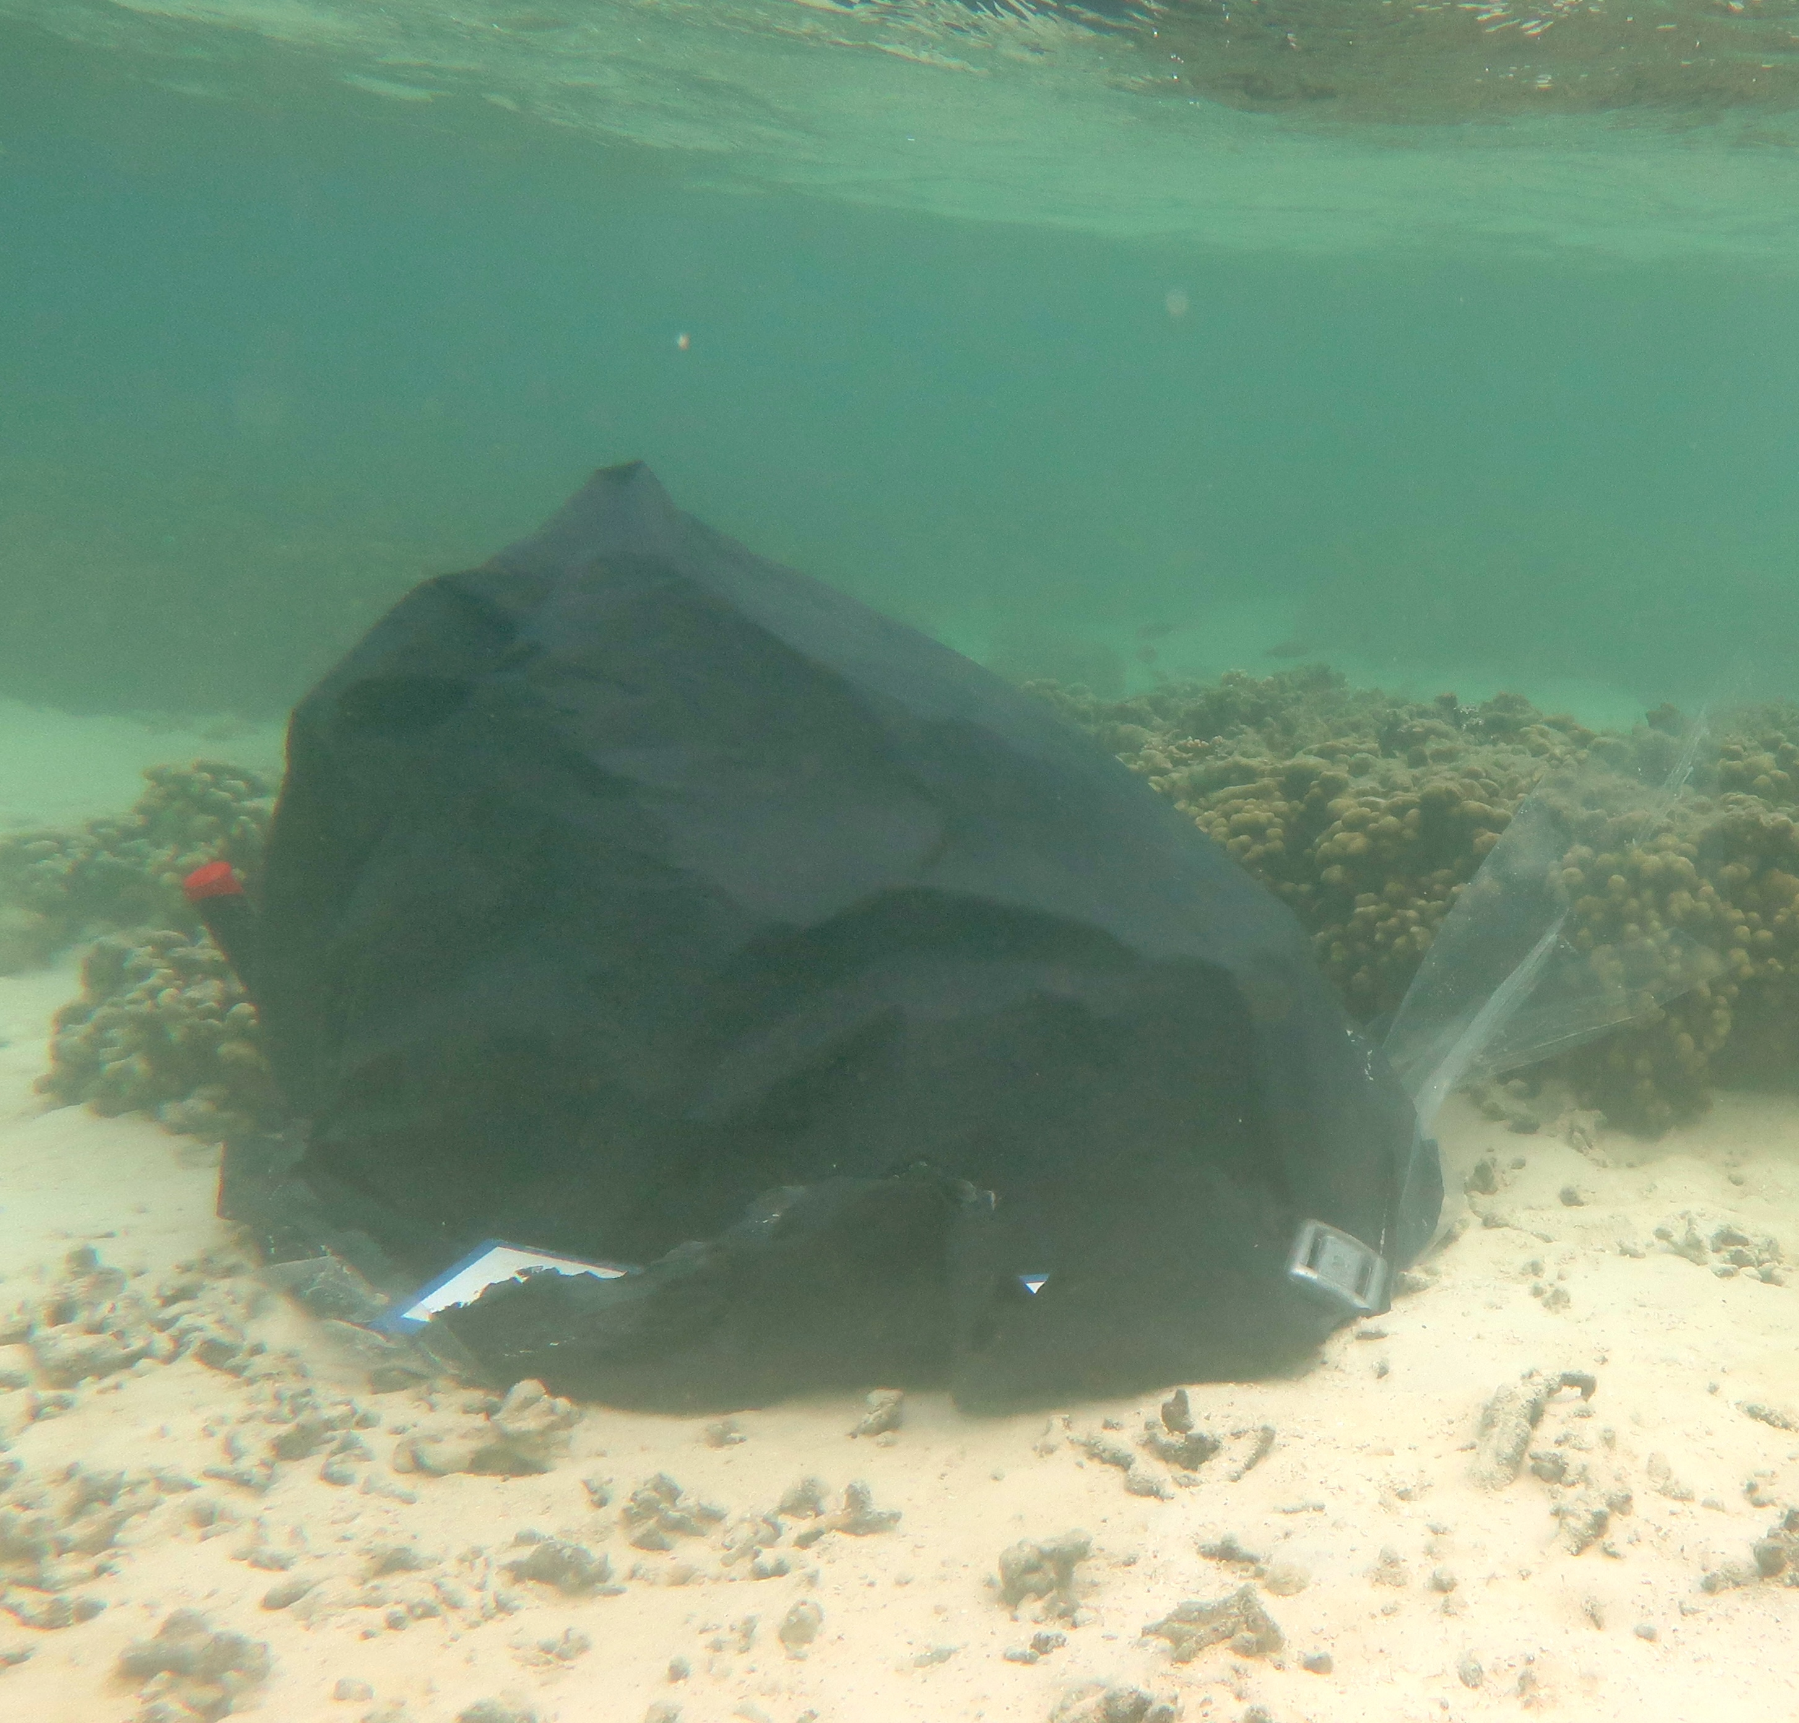
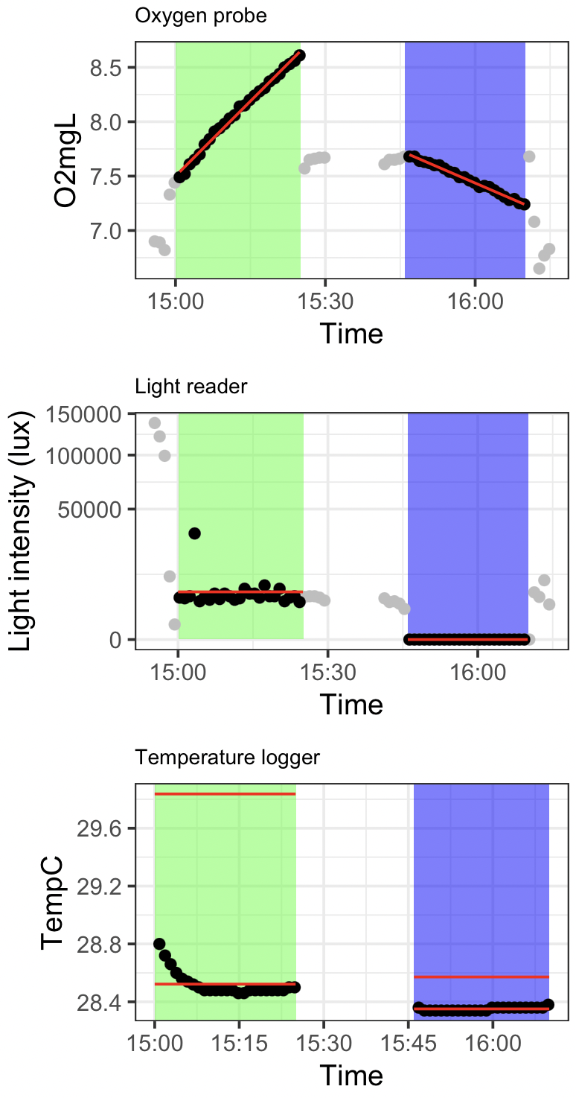
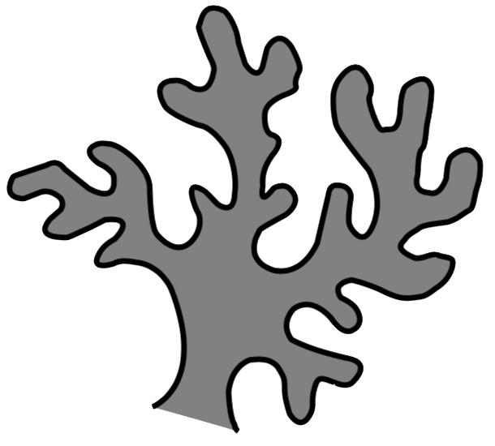
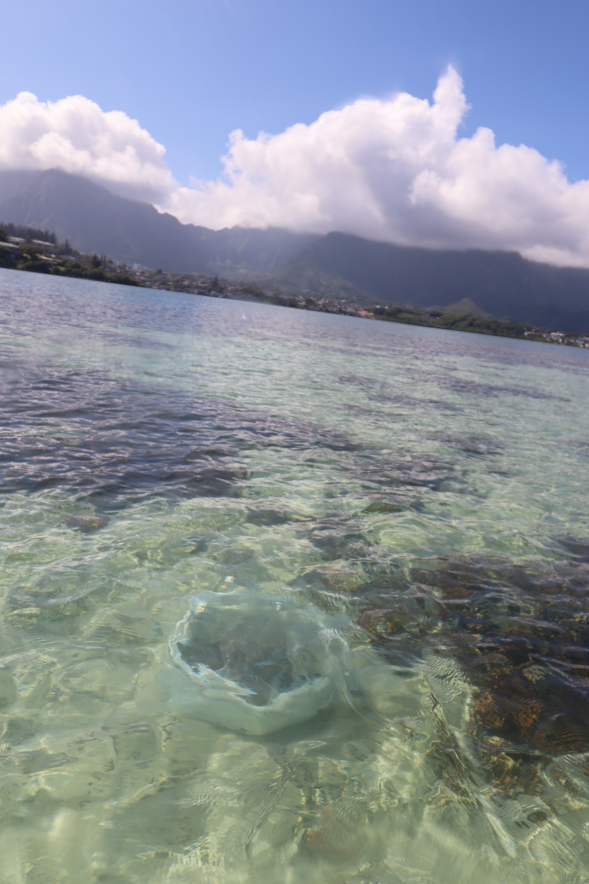
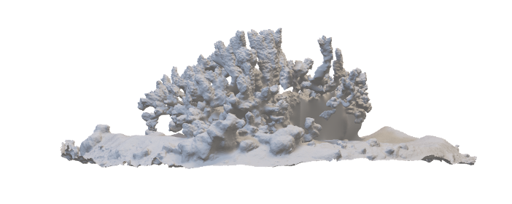
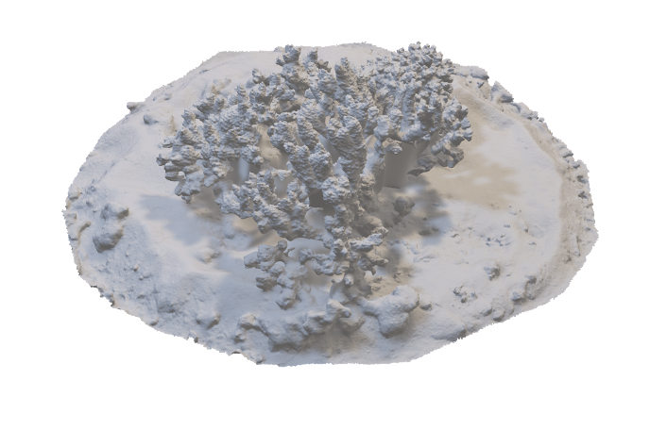
a
c
Transparent, flexible sheet
Wave-driven water flow
Solid cylinder
Light & temp. probes
O₂ probe
Water
tight seal
Weight
5cm into sand
b

Slide 2
Light & temp. probes
Water
tight seal
Solid cylinder
O₂ probe
5cm into sand
Weight
Transparent, flexible sheet

Slide 3
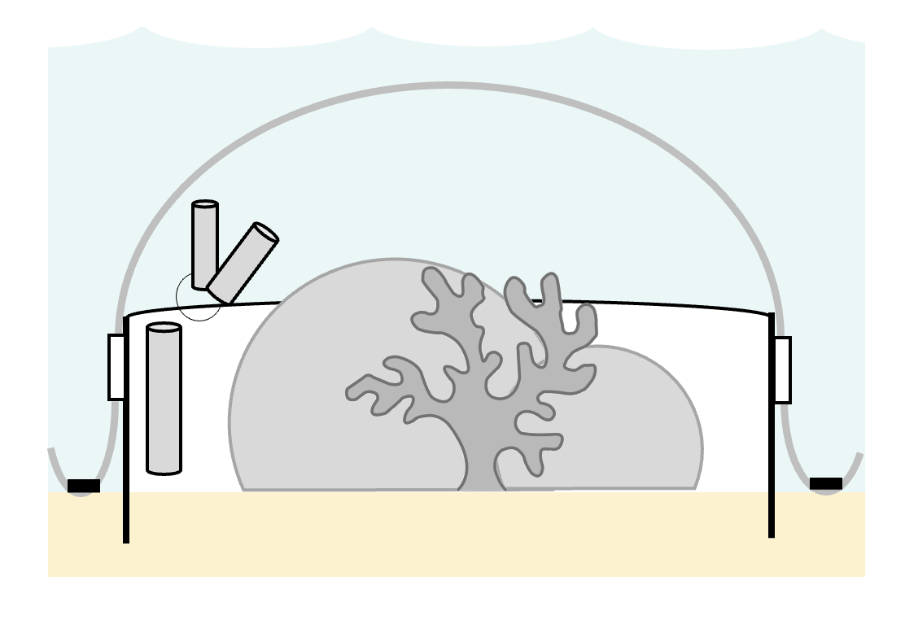
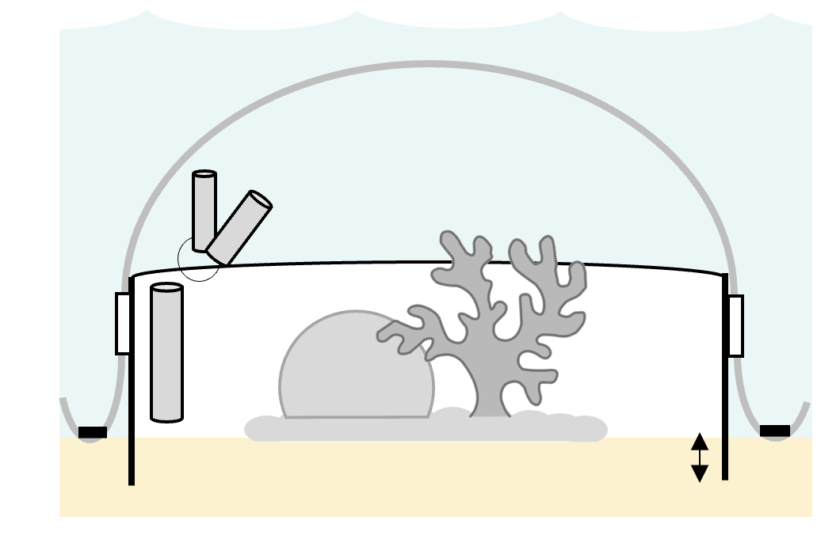
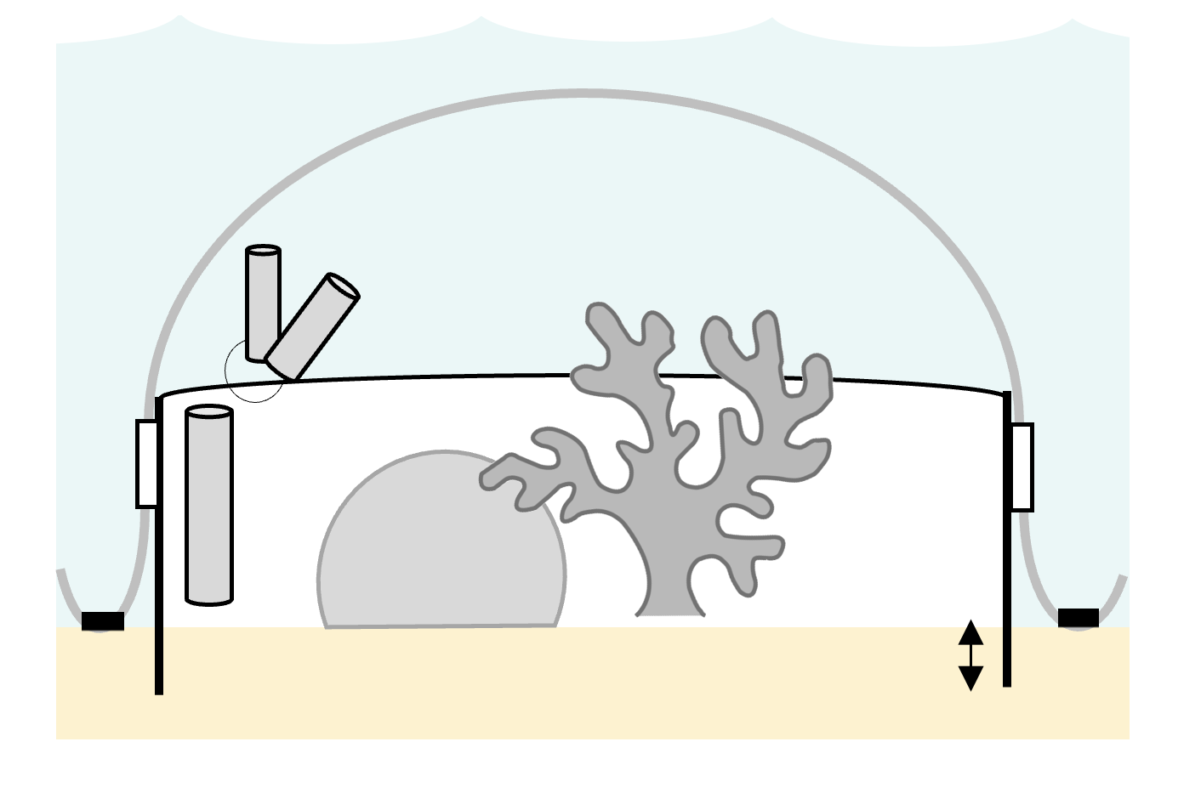
Transparent, flexible sheet
Temp & light probe
Solid cylinder
Ratchet strap
O₂ probe
Weight
60cm

